Slide 1
Ending Gas Expansion
The Myth of the “Bridge” Fuel
Notes:
ID=d924773e-9a16-4d6d-9803-8cb819e99682 Recipe=text_billboard Type=TextOnly Variant=0 FamilyID=AccentBoxWalbaum_Zero

Slide 2

Table of Contents
History of Fracked Gas
Methane and Fossil Gas
Methane Pipeline Leakage
Energy Alternatives: Transition to Renewables
What YOU can do

Slide 3
The Shale Revolution in the US
Spread of horizontal drilling and hydraulic fracking enable increase oil and gas production
US oil imports hit a two-decade low
US becomes world’s largest crude oil producer
2008
2009
2015
2016
2018
US becomes the world’s largest producer of fossil gas
US crude oil pipeline capacity exceeds 70,000 miles
Wemer, D. A. (2019, January 18). Energizing conversations on oil at the Atlantic Council’s Global Energy Forum in Abu Dhabi. Atlantic Council.

Slide 4



The “Bridge Fuel” Myth
Oil and gas corporations have falsely branded gas as a cleaner fossil fuel for over three decades
Slowing the transition to renewable energy alternatives
Gas in NOT clean or cheap and is not a bridge to a safe climate
Oil Change International. (2019, May). Burning the Gas “Bridge Fuel” Myth: Why Gas is not
Clean, Cheap, or Necessary

Slide 5
Methane, Fossil Gas, and Climate
Methane is the primary constituent of fossil gas
Gas delivered through pipelines is 90% methane
Methane-based gas emits carbon dioxide (CO2)
According to the Intergovernmental Panel on Climate Change (ICCP) methane has an 87 times greater warming effect than CO2 over a 20-year period
Oil and gas infrastructure is the primary source of rising methane in the atmosphere over the past decade
If climate goals in line with the Paris Agreement are to be met, gas production needs to be phased out
Oil Change International. (2019, May). Burning the Gas “Bridge Fuel” Myth: Why Gas is not Clean, Cheap, or Necessary

Slide 6
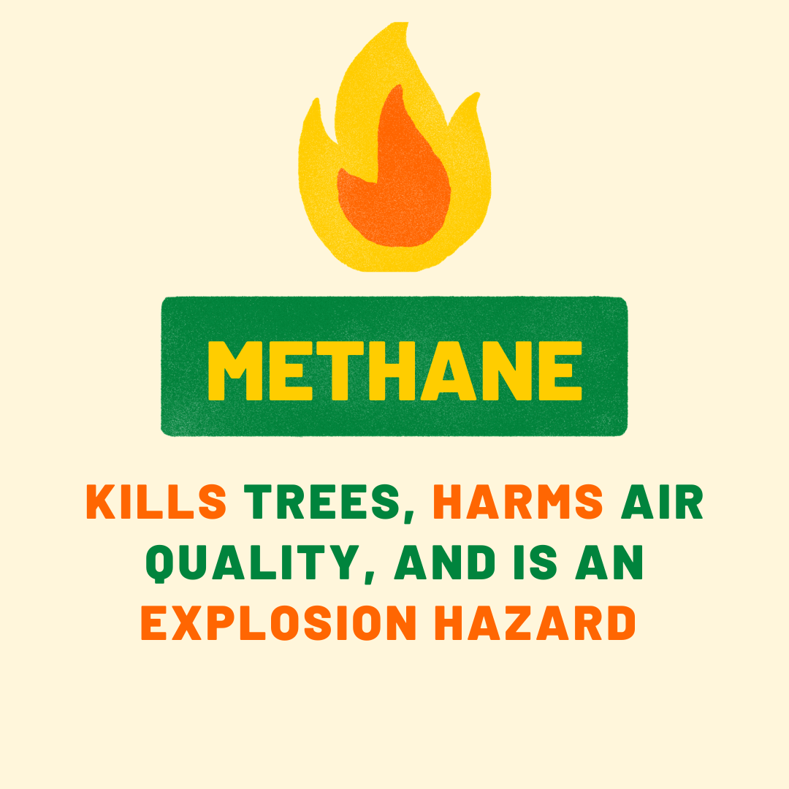
Environmental & Health Hazards
Oil and gas production brings pollution, habitat destruction, and health and safety risks for host communities
Methane emissions result from combustion, gas storage and equipment, pipeline leaks, and purposeful venting
An enhanced procedure for urban mobile methane leak detection. (2020). Heliyon, 1–12.

Slide 7
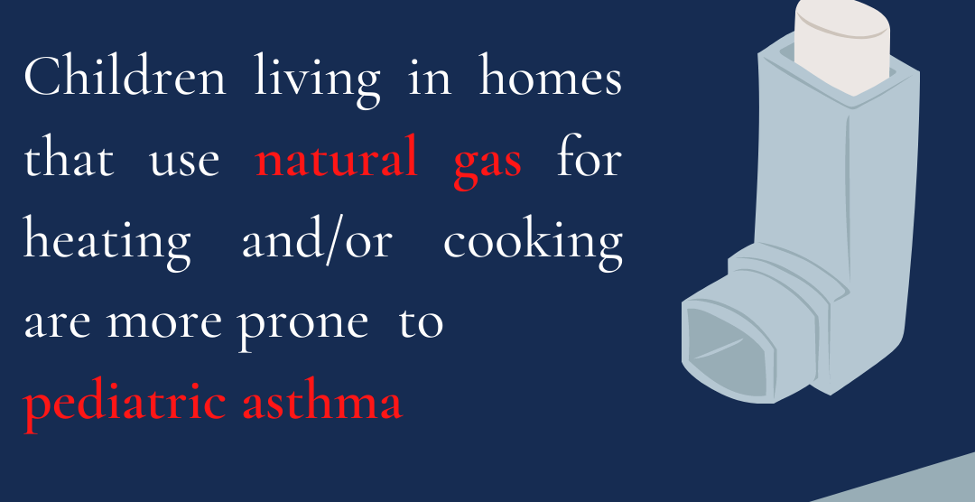

Slide 8
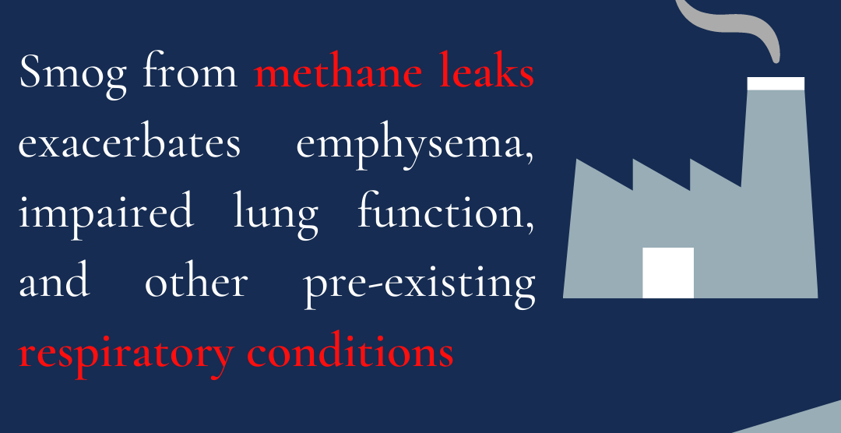

Slide 9
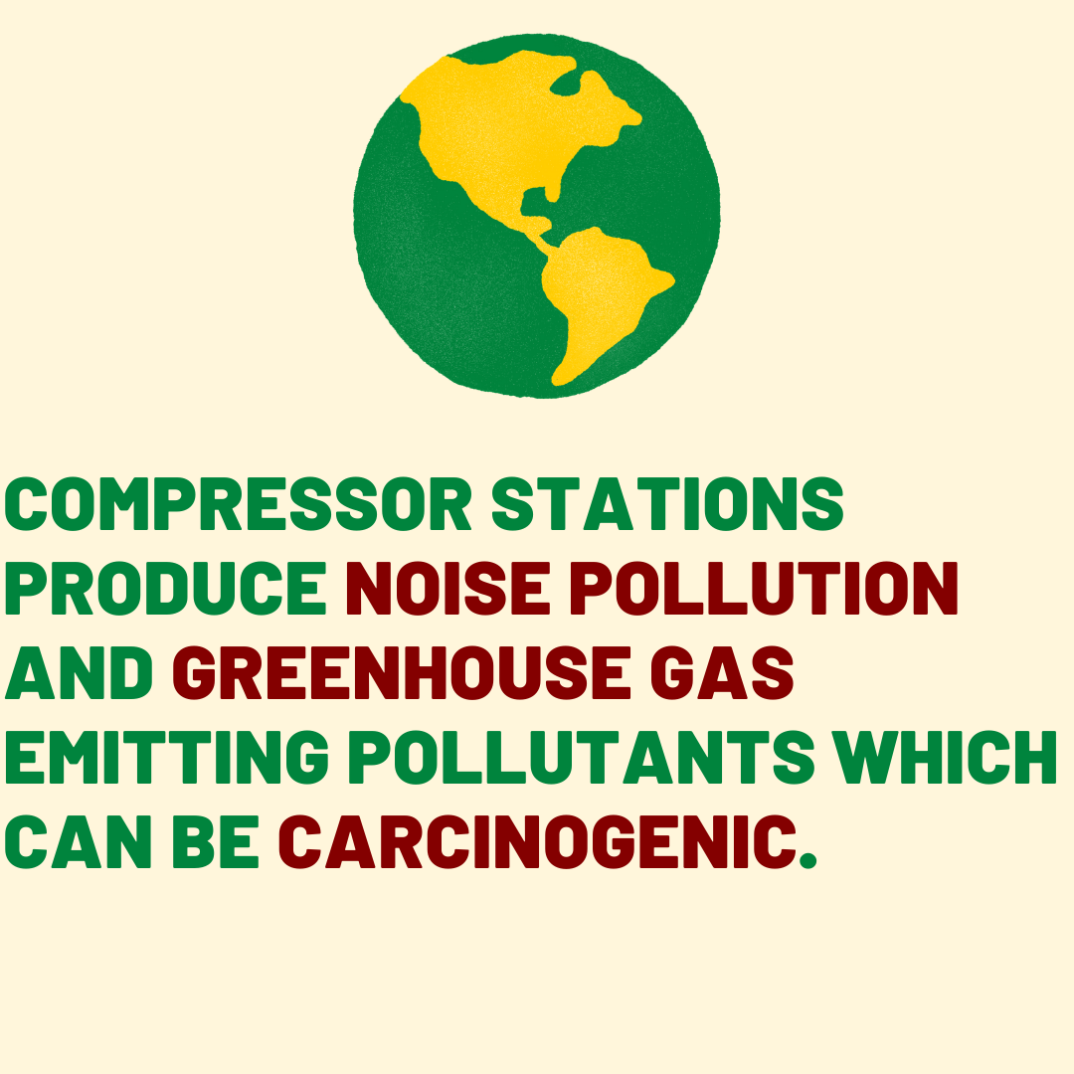

Slide 10
Pipe Leakage in CT
Fossil gas that flows through Connecticut pipelines is fracked from the Marcellus Shale in Pennsylvania and Ohio
The volume of fossil gas leaked in cities causes major climate and economic impacts
McKain et. Al, 2015 showed that greater Boston lost 2.7% of total consumed gas due to pipe leaks for a value loss of $90 million in part borne by ratepayers
A total of 716 distinct methane leaks over 225.45 road miles in Hartford were detected in 2016 resulting in a leak frequency of 3.2 leaks per road mile
Similarly, an update 2019 gas leak study found 4.3 leaks per road mile
Tim Keyes, Gale Ridge, Martha Klein, Nathan Phillips, Robert Ackley, Yufeng Yang, An enhanced procedure for urban mobile methane leak detection, Heliyon, 2020

Slide 11
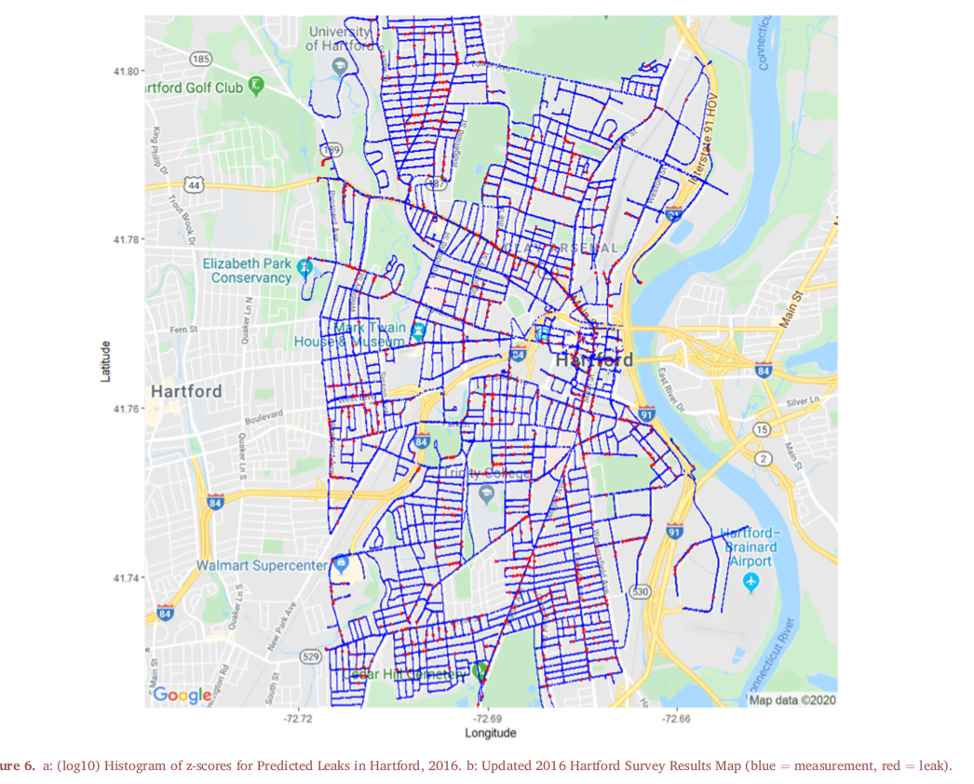

Slide 12
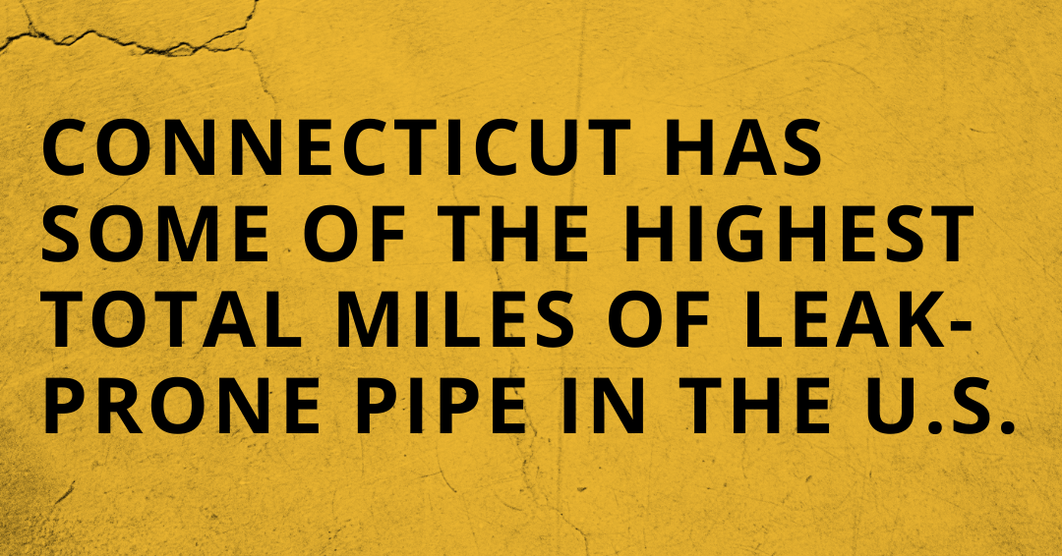

Slide 13
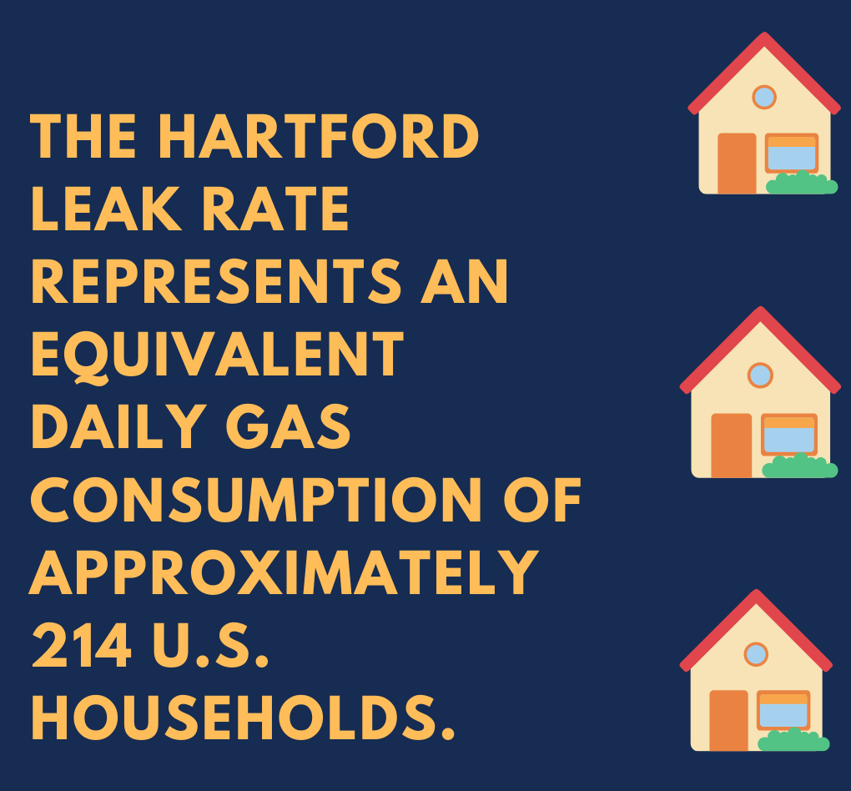

Slide 14
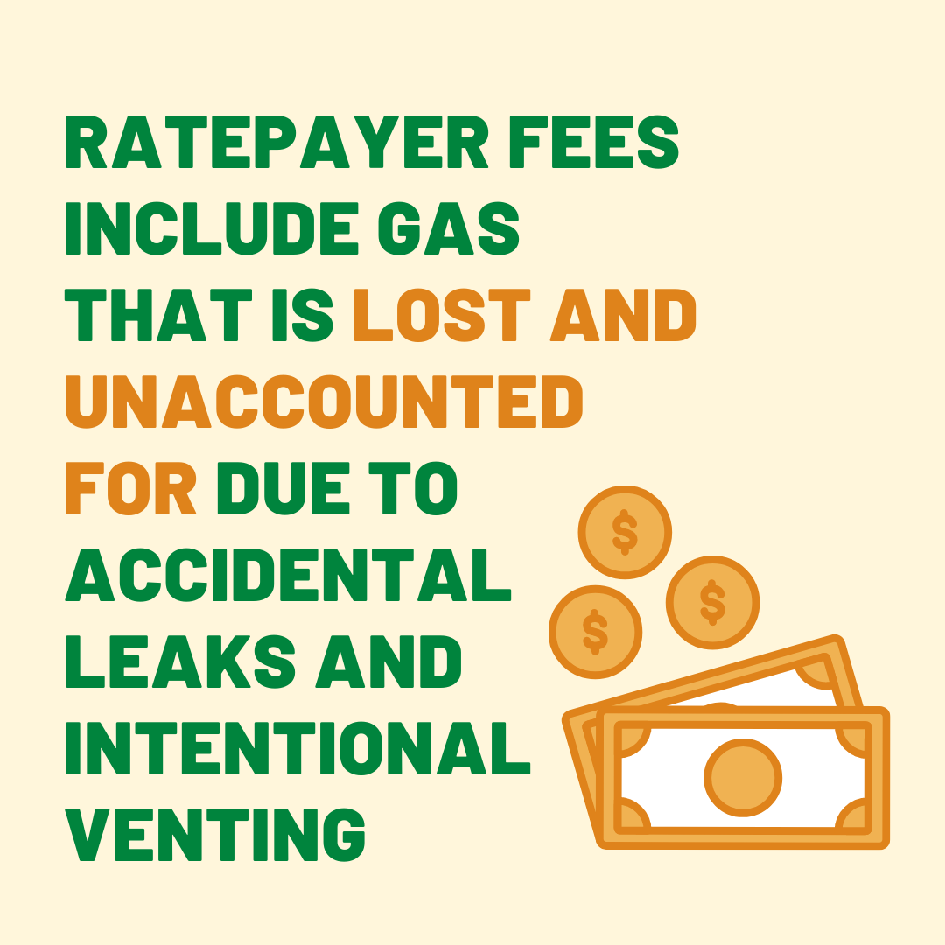

Slide 15
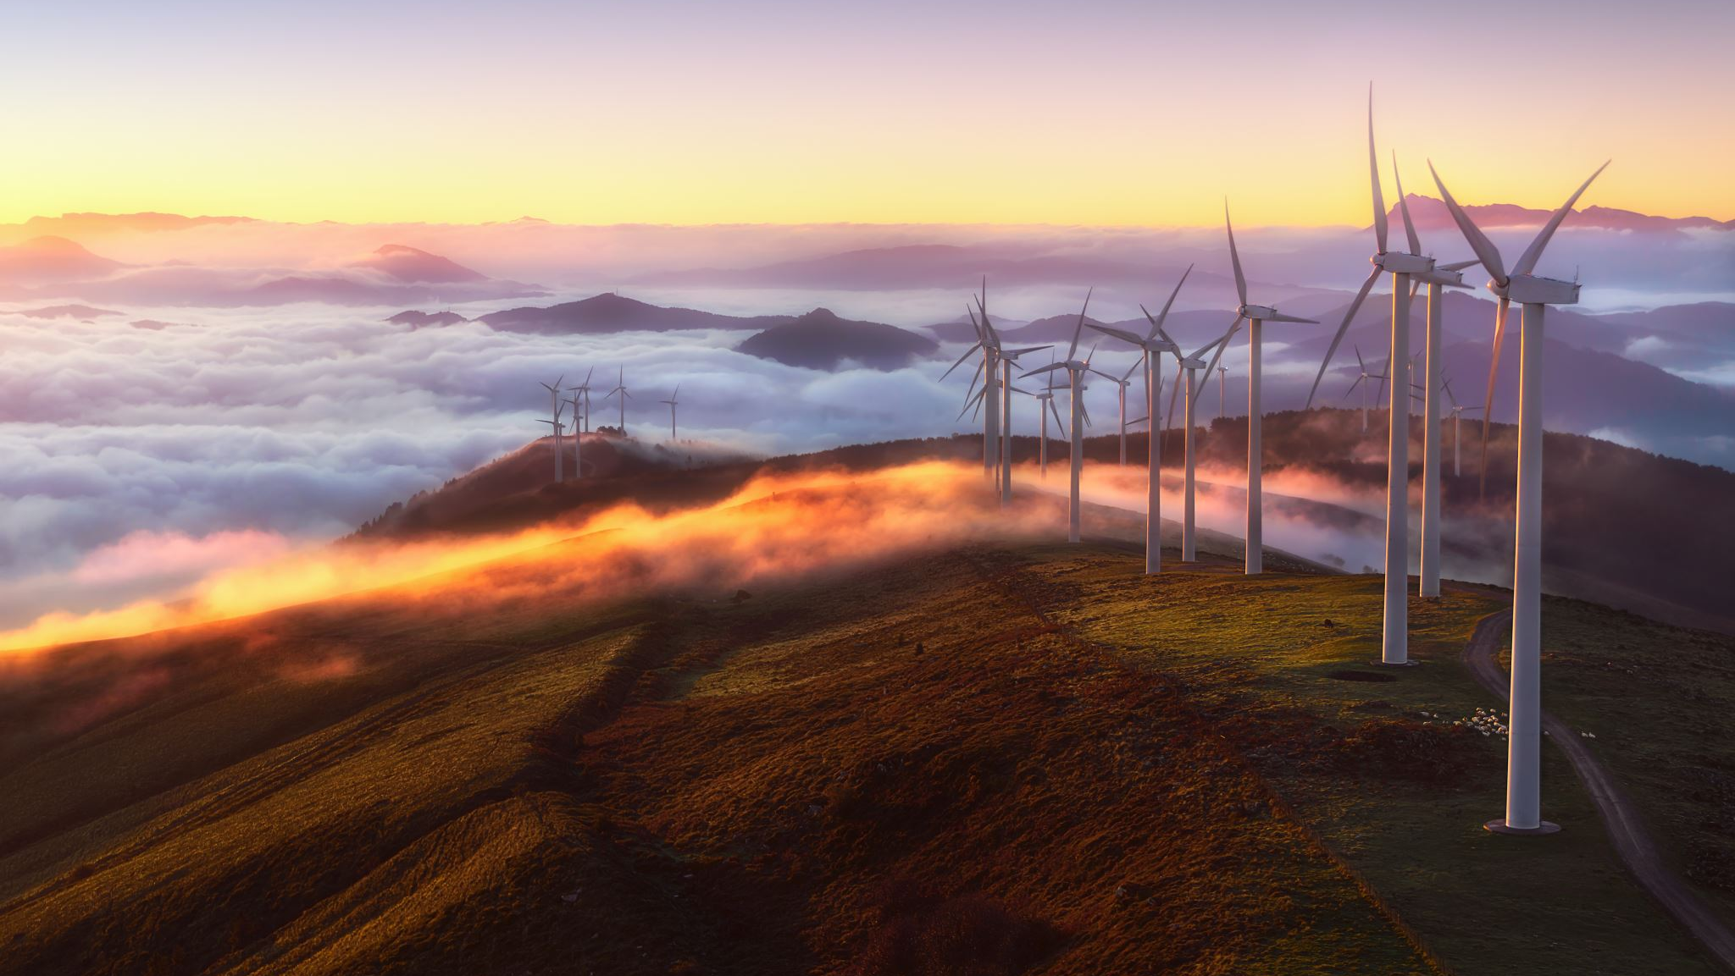
Renewable Energy Transition: Deploying Distributed Generation

Slide 16
Reaching Carbon Zero: Clean, Renewable Energy
Since 2000, the electricity grid in CT has quadrupled energy from fracked gas and created virtually no renewable power in the state
Fossil fuel companies have falsely claimed that only fossil gas can affordably replace coal and nuclear energy
Cost has been a constraint in the past, but energy efficiency can reduce demand and today wind and solar have become the cheapest form of bulk energy supply for most major markets
Renewable energy can save consumers money
This cost advantage will continue to grow over time

Slide 17
Renewables and Grid Reliability
Gas proponents emphasize the variability of wind and solar, both intermittent resources
Gas generators known as peakers are being challenged on cost by battery storage
The International Renewable Energy Agency (IRENA) contends that in order to maximize renewable energy capacity and foster the solutions to wind and solar variability, policymakers must support investment in renewable technologies, none of which include gas.
Ideas and perspectives: is shale gas a major driver of recent increase in global atmospheric
methane? (2019). Biogeosciences, 3033–3046.

Slide 18



How can YOU help
EDUCATE
PETITION
VOLUNTEER

Slide 19

Conclusion
New gas infrastructure locks in emissions and prevents us from reducing CO2 emissions
As for gas, we need less, not more of it

